Slide 1
Machine Learning based Airline Customer Satisfaction Prediction using Classification
Team Members
Akshay Joshi
Ashish Kumar Gupta
Manjunath M
Nitin Bhojraj Chaudhari
Prerana H
Mentored by
Koneti Naveen Kumar Yadav

Slide 2
Problem Definition
Customer Satisfaction is one of important factor for any business to sustain in 21st century. Airline Industry faces customer satisfaction issue for the provided services by airline. The objective or goal of this project is to guide an airline company to determine the important factors that influences the customer or passenger satisfaction.
Why ?
In the covid era, travelling to different states/countries has become a biggest challenge for every individual. On the other hand, airline industry wants to attract more customer to maintain their revenue and recover loses due to covid.
Outcomes planned
We planned to provide important features to airline franchise which really impacts customer satisfaction using machine learning classification model.

Slide 3
Dataset Description
Dataset url: https://www.kaggle.com/binaryjoker/airline-passenger-satisfaction
Independent Features:
Dependent features:
Rating Scale:

Slide 4
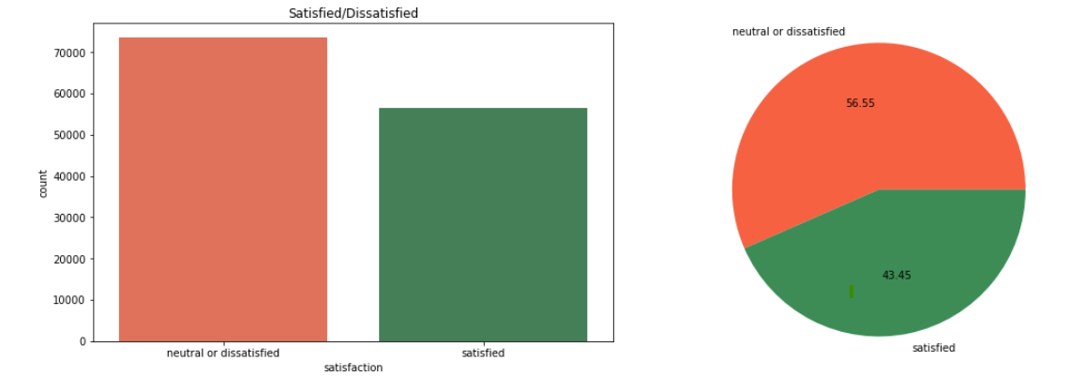
Exploratory Data Analysis
Target feature Analysis
The target feature in our dataset is ‘Satisfaction’ which displays overall customer satisfaction towards customer facing facilities provided by the airlines.
We see that the distribution of target feature is 57:43 approx. And this distribution helps us to consider the dataset as balanced.

Slide 5
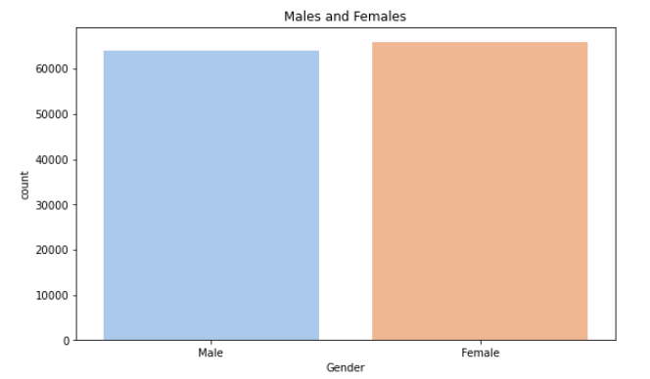
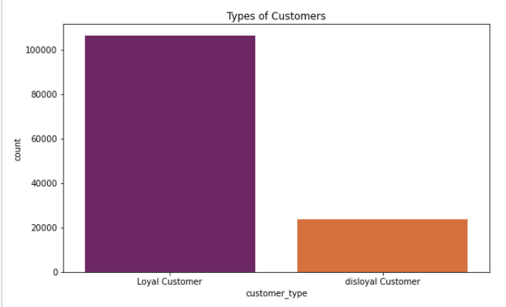
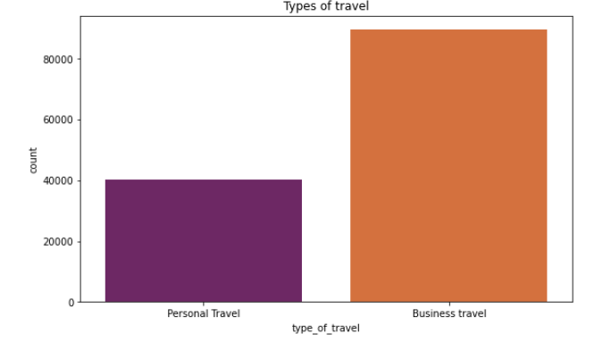
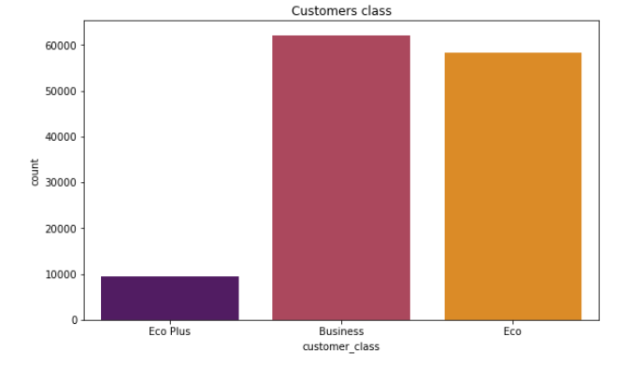
Univariate Analysis
Categorical Features:

Slide 6
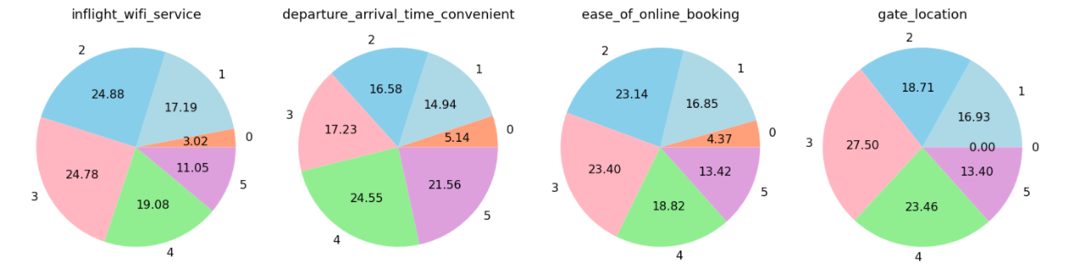
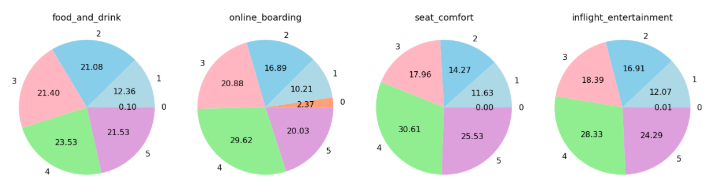
Univariate Analysis
Rating features Analysis
Notes:
Inflight wifi services: Majority of customers have rated 2 or 3 stars for Inflight Wi-Fi services, Only 11% of customers have given 5 star rating. On whole, only 30% customers are satisfied with inflight-Wi-Fi service.
Ease of online booking: Majority of customers have rated 2 or 3 stars , only 32% of customers are satisfied with online booking system facility
departure_arrival_time_convenient: Majority of them rated 4 and 5 implying that only 45% of customers are satisfied with airline flight timings and might have not have faced delay. The 55% of travelers have faced flight delay issues.
Gate Location: Majority customers have give 3 or 4 as the rating, Only 13% of customers has given 5 as rating. On whole,36% of travelers are satisfied with the gate location.
Food and drink: majority of customers have provided 2, 3 and 5 rating in equal percentages, On whole, 45% of travelers are satisfied with food and drink.
Online boarding: Many customers have rated for 4. On whole,49% travelers are satisfied with online boarding facility.
Seat comfort: Many customers have rated for 4. On whole, 56% customers are satisfied with seat comfort.
Inflight Entertainment: Many customers have rated for 4. On whole, 52 % travelers are satisfied with inflight entertainments.

Slide 7
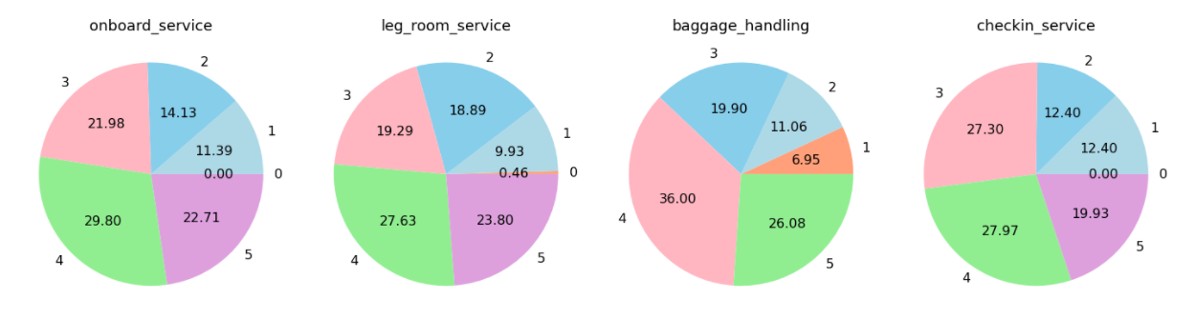
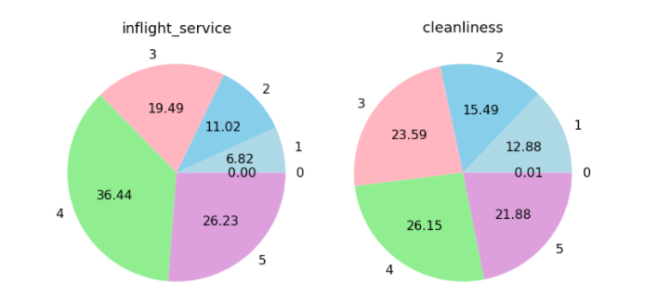
Univariate Analysis
Rating features Analysis
Notes:
Onboard Services: Many customers have rated for 4. On whole, 52% travelers are satisfied with Onboard service.
Leg Room Services: Many customers have rated for 4.On whole, 50% travelers are satisfied with leg_room_service.
Baggage Handling: Many customers have rated for 4. On whole,62 % travelers are satisfied with baggage handling.
Check_in-service: 47% travelers are satisfied with check-in-service.
Inflight Service: Many customers have rated for 4. On whole, 62% travelers are satisfied with inflight_service.
Cleanliness: Many customers have rated for 4. On whole, 47% travelers are satisfied with cleanliness.

Slide 8
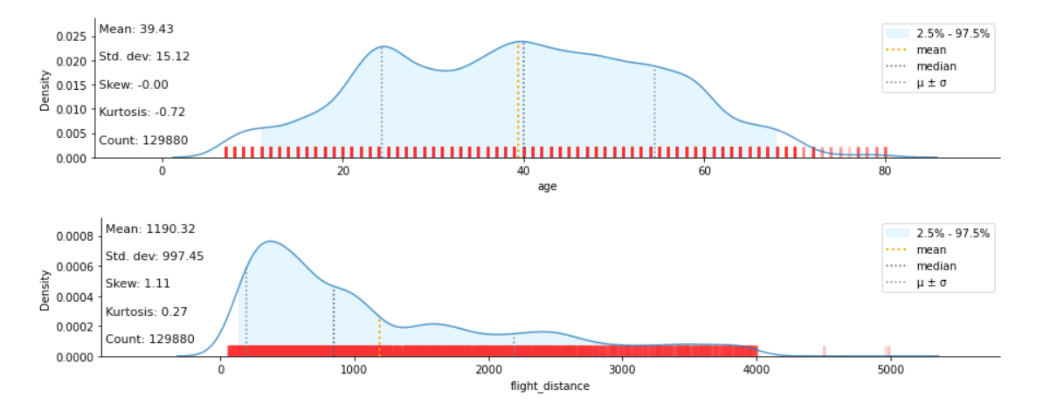
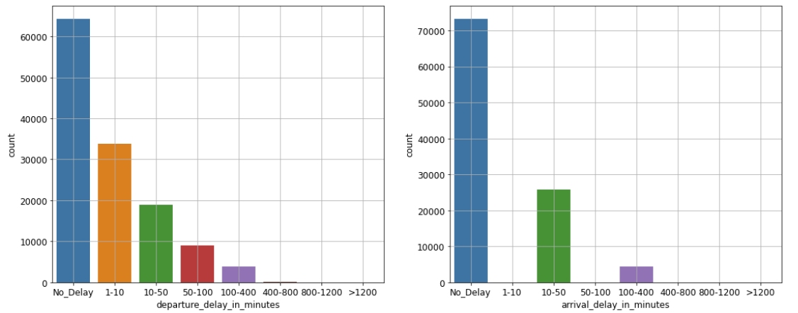
Univariate Analysis
Numerical features Analysis
Notes:
Age: The airline franchise has more travelers in the age group 22 to 57.
Flight_distance: More traveler have opted the airline franchise for short distance travel in the range 31 to 1000 miles.
More than 50% of the passengers have not faced delay in departure and arrival time.

Slide 9
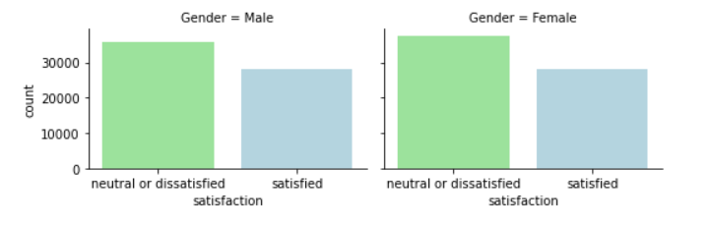
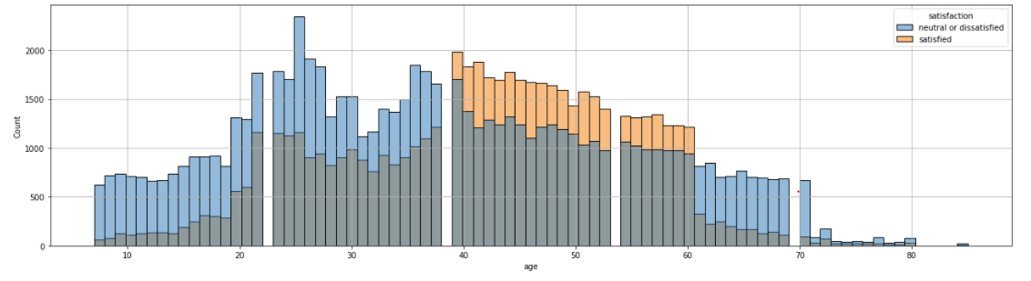
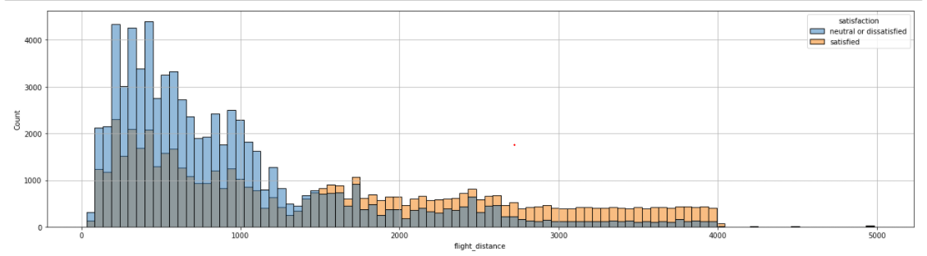
Bivariate Analysis
Gender Vs Satisfaction
Customer_type Vs Satisfaction
Age Vs Satisfaction
Flight distance Vs Satisfaction
Notes:
Gender Vs Satisfaction
It is observed that gender distribution of neutral/dissatisfied and satisfied customers are similar.
For both male and female passengers, number of neutral/dissatisfied customers are on the higher when compared to number of satisfied customers.
Customer_type Vs Satisfaction
Even among loyal passengers which are high in number, the ratio of satisfied and neutral/dissatisfied ones are almost close to 49:51.
Age Vs Satisfaction
From age 7-to-38 and from age 61-to-79, the number of neutral/dissatisfied passengers is very high compared to satisfied passengers.
On the other hand, in age group 39-60, the number of satisfied passengers is higher compared to neutral/dissatisfied passengers.
Flight distance Vs Satisfaction
for shorter flight distance from 31-1350 miles, mostly passengers are dissatisfied with airline services.
for large distance flights from 1351-4983 miles, most of the passengers are satisfied with airline services.

Slide 10
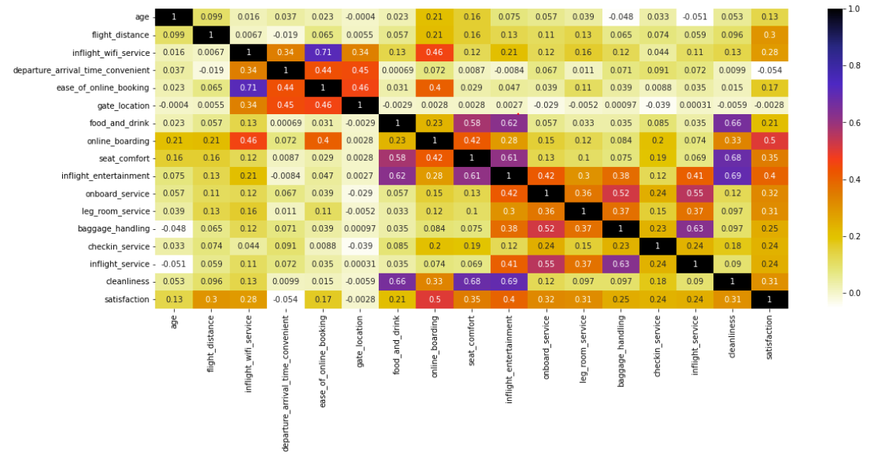
Bivariate Analysis
Correlation plot
Notes:
"Ease_of_Online_booking" is highly correlated with "Inflight_wifi_service" and "Inflight_service" is highly correlated with "Baggage_handling". But no pair is having correlation coefficient exactly equal to 1. Therefore there is no perfect multi-collinearity. Hence we are not discarding any variable.
Most of the independent features have moderate or no correlation with the target feature (satisfaction). There isn’t any feature which is strongly correlated with target feature.

Slide 11
Bivariate Analysis
Few more insights
It is observed that gender distribution in customer types, type of travel and customer classes are similar.
More % of disloyal customers are business travelers only.
More % of business travelers are considered as loyal customers with the airline.
Very less % of personal travelers are considered as disloyal customer in comparison to business travelers.
We can observe more loyal customer traveling in eco plus class.
There is an equal proportion of gender for Loyal and Disloyal Customers.
The departure delay and arrival delay are positively correlated. And this has also raised the traveler dissatisfaction % to 55%.

Slide 12
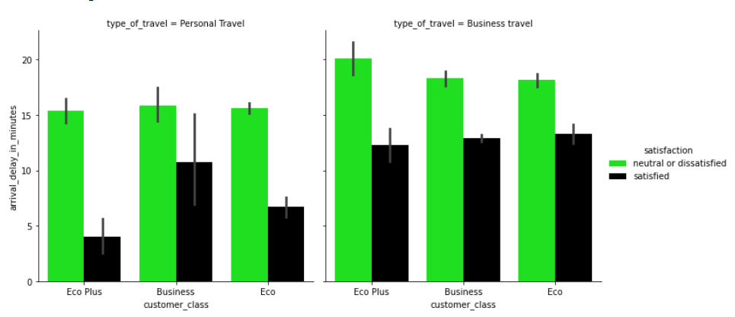
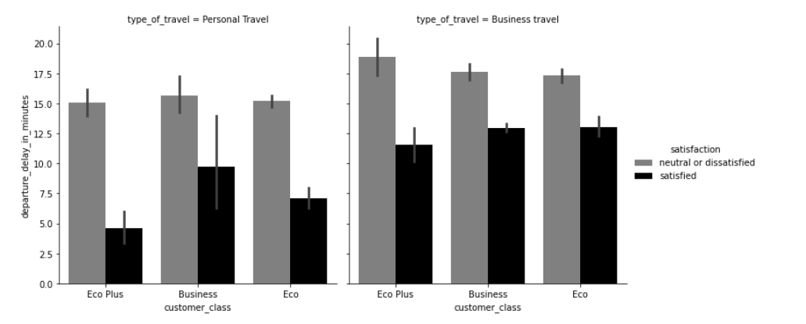
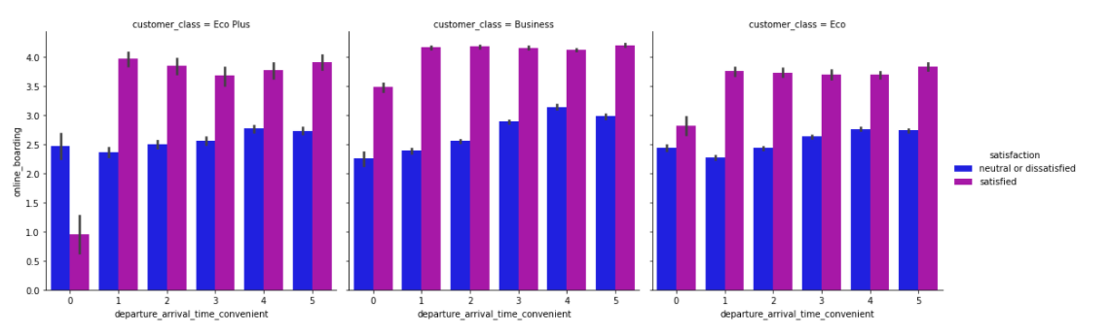
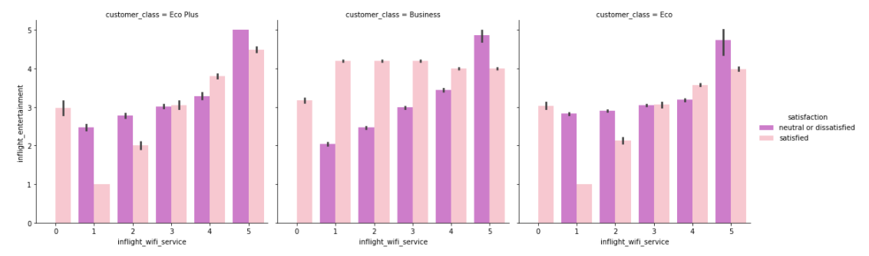
Multivariate Analysis
Notes:
For any customer class and for any type of travel, customers are dissatisfied when there is a delay in the departure or in arrival time.
For Eco Plus class, very inconvenient Departure/Arrival time i.e., departure_arrival_time_convenient = 0 has high number of neutral/dissatisfied passengers, even when online boarding is on positive side. For other combinations, the number of satisfied passengers are higher compared to number of neutral/dissatisfied passengers.
Eco Plus passengers are mostly satisfied without inflight Wi-Fi service (rating 0) and with moderate level of in-flight entertainment (rating 2 - 4).
For Business class passengers, only highest level of in-flight entertainment (rating 5) can bring satisfaction in them.
For Eco passengers, high level of in-flight entertainment (rating 3 - 5) and very high Wi-Fi service availability (rating 5) can make them satisfied.

Slide 13
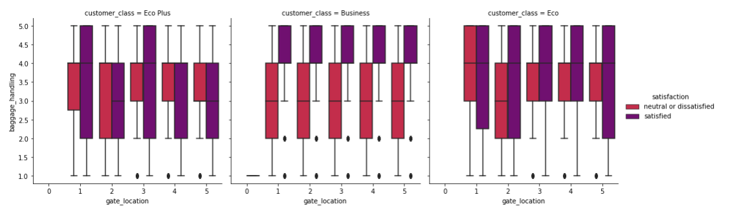
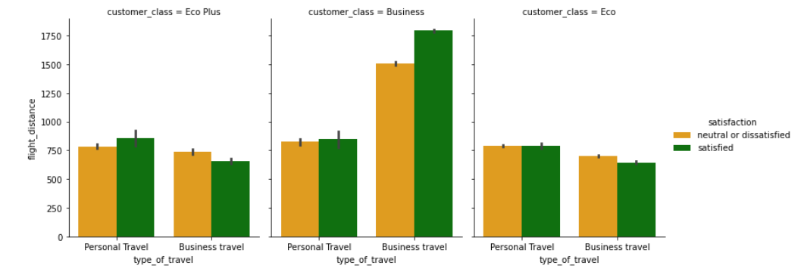
Multivariate Analysis
Notes:
For business class passengers, it is observed that all gate locations have higher number of neutral/dissatisfied passengers when baggage handling is not upto the satisfactory level (rating <= 4).
For Eco Plus class, when the gate location is 1 and for Eco class, when the gate location is 2, even when the baggage's are handled in a mediocre way (rating 2 to 4), passengers remained neutral/dissatisfied.
For business travel in business class category, the number of satisfied passengers are quite on the higher for longer flight distance.
For other combinations, almost equal distribution of satisfied and neutral/dissatisfied passengers is present.

Slide 14
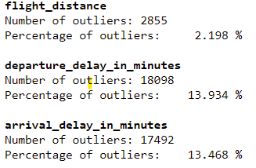
Feature Engineering
Imputed null values by using KNN imputation.
Checking for outliers in the data:
Applying Power Transformation which scales and transforms numerical columns.
One-Hot Encoding of categorical columns.
Combining one-hot encoded data and the transformed data.
Splitting the data to train and test dataset.

Slide 15
Statistical Test Output:
feature | p_value
gate_location | 0.21
Gender | 0.00
departure_arrival_time_convenient | 0.00
departure_delay_in_minutes | 0.00
arrival_delay_in_minutes | 0.00
customer_type | 0.00
type_of_travel | 0.00
customer_class | 0.00
age | 0.00
flight_distance | 0.00
inflight_wifi_service | 0.00
ease_of_online_booking | 0.00
food_and_drink | 0.00
online_boarding | 0.00
seat_comfort | 0.00
inflight_entertainment | 0.00
onboard_service | 0.00
leg_room_service | 0.00
baggage_handling | 0.00
checkin_service | 0.00
inflight_service | 0.00
cleanliness | 0.00
For categorical features, we have performed the chi2contingency test from scipy library.
For numerical features, as the data is not normally distributed, we have used the Kruskal test to validate the relationship between independent and target features.

Slide 16
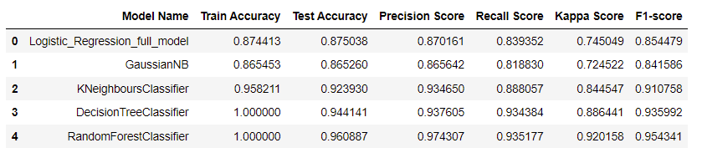
Model Building
We split the dataset after cleaning and transformation into train and test part in 80:20 using pareto principle.
We fitted the base model using different classification machine learning algorithm to evaluate the model performance.
Base Model Output
From the base model fit, we decided to go with RandomforestClassifier as it is provided maximum test accuracy and precision score.

Slide 17

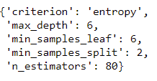
Bias and Variance Error
RandomForestClassifier
We evaluate and model goodness and stability using the cross validation scores.
From above scores, we infer that the model is performing good and it is stable too.
Also there is no overfitting observed for the RandomForestClassifier.
Hyperparameter tuning
RandomForestClassifier
The best parameters obtained are:

Slide 18
Tuned RandomForestClassifier
Model Name | Train Accuracy | Test Accuracy | Precision Score | Recall Score | Kappa Score | F1-score
Tuned RandomForestClassifier | 0.928857 | 0.926317 | 0.923546 | 0.906465 | 0.849953 | 0.914926
Check for Goodness and Stability of tuned RandomForestClassifier
Score | 0.92503133 0.93131336 0.92846583 0.93047945 0.93171731
Bias Error | 0.071
Variance Error | 0.003
Feature Importance for tuned RandomForestClassifier (Top5)

Slide 19
Business Interpretation
The airline industry has to focus more on features mentioned below:
1. online boarding
2. inflight_wifi_service
3. inflight entertainment
4. customer_class_Eco
5. type_of_travel_Personal Travel
These features helps airline to gauge more customer satisfaction and it also helps airline to attract more passengers which helps to increase revenue.
Model deployment url: Airline Customer Satisfaction Prediction Model

Slide 20
Thank You

